Slide 1

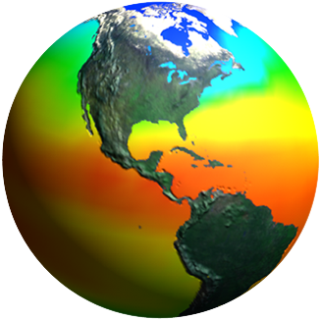
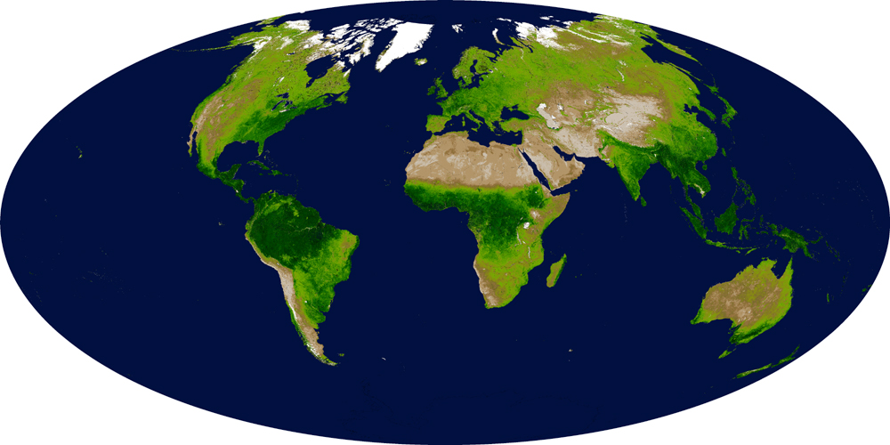
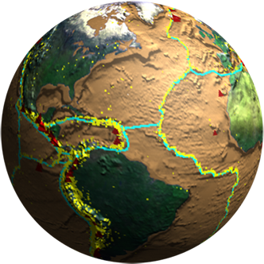
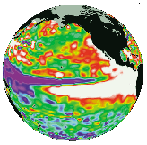

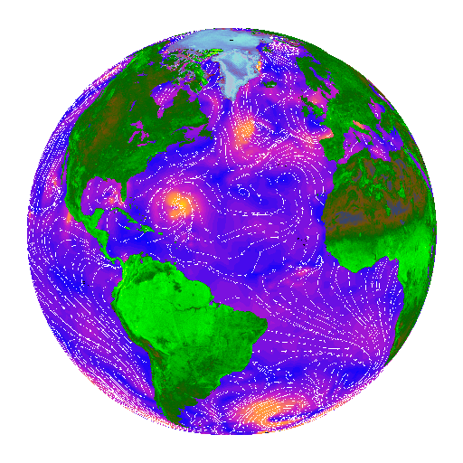
U.S. Marine Biodiversity Observation Network (MBON) All-Hands Meeting
Marriott Hotel and Conference Center, College Park, MD
MBON in the Global Community
Woody Turner
Earth Science Division
NASA Headquarters
(with thanks to Frank Muller-Karger for several slides)
April 24, 2015

Slide 2
Group on Earth Observations (GEO)
A Framework for Integration
Notes:
Ad hoc GEO was established in 2003.
April 2015, 97 members
87 participating organizations: intergovernmental, international, and regional organizations with a mandate in Earth observation or related issues have been recognized as Participating Organizations

Slide 3
GEO Biodiversity Observation Network (GEO BON)
(https://www.earthobservations.org/geobon.shtml)
A developing global observation network for biodiversity focused on three questions:
  What is changing?
  Why is it changing?
  What are the impacts?
Realms: Freshwater, Marine, Terrestrial
Scales: Ecosystems, species, genes; also ecosystem services
Essential Biodiversity Variables
BON in a Box
Example Product: Global Marine Environment Datasets
Nine Working Groups
  Genetics
  Terrestrial Species Monitoring
  Terrestrial Ecosystem Change
  Freshwater Ecosystem Change
  Marine Ecosystem Change
  Ecosystem Services
  In situ/RS Integration and Modeling
  Data Integration & Interoperability
  Biodiversity Indicators
Regional BONs
  EU BON
  AP BON
  Circumpolar Biodiv. Monitoring Prog.
National BONs
  France

Slide 4
GEO BON & Marine BON Connections
Marine BON is a U.S. contribution to GEO BON—as stated in the solicitation—adopting the GEOSS data sharing principles calling for full and open exchange of data/metadata
GEO BON Working Group 5 (Marine Ecosystem Change)
  August 2014: WG5 established Task Team (WG5TT) to define MBON’s role in GEO BON
    Includes 3 US MBON project leads, GOOS, OBIS and I-OBIS, GEO BON representatives, others
    Developed Terms of Reference
  Listserv for WG5TT created 2015
      Steering Committee for TT formed to identify “action areas”
      Approximately monthly telecons
Vision: A global network of marine observation networks that monitors all key aspects of biodiversity-relevant change to support policy, decision making, and healthy and sustainable oceans
Core topics:
  What makes an MBON?
  Integration of US MBON projects with GEO BON
  Linkages with GOOS Biology & Ecosystems Panel
  Linkages with IOC-OBIS/UNESCO
  Defining best practices, toolkits, understanding the diversity of sampling, data storage, sharing practices, etc.
  Forum for coordination mechanisms for potential international Marine BONs
Major challenge in addressing GEO BON goals (short and long term):
  Need to build international funding framework

Slide 5
International Opportunities
Future Earth Symposium on Global Biodiversity Monitoring, May 4-7, New Haven, Connecticut
International Symposium on Remote Sensing of Environment (ISRSE), May 11-15, Berlin, Germany
27th International Congress for Conservation Biology (ICCB), August 2-6, Montpellier, France
GEO Plenary and Ministerial Summit, November 11-13, Mexico City, Mexico
2016 Ocean Sciences, February 21-26, New Orleans, LA
International Marine Conservation Congress, July 30-August 3, 2016, St. Johns, Newfoundland and Labrador, Canada
How can we build an international network?

Slide 6
Draft Guiding Principles for MBON
(Draft)
• Ownership: the MBON should have stakeholders.
• Sustainability: build on existing monitoring infrastructure and management structures; MBONS should meet the needs of the present without compromising future capability.
• Stewardship: balancing different uses of resources for the continued benefit of organisms and also of people that use or are related to the area covered.
• Ocean–Land–Atmosphere Connections: recognize that the oceans, land, and atmosphere are inextricably intertwined and that actions that affect one component are likely to affect another.
• Ecosystem-based Management: resources should be managed to reflect the relationships among all ecosystem components, including humans. This will require defining relevant geographic management areas based on ecosystem, rather than political, boundaries.
• Multiple Use Management: The many potentially beneficial uses should be acknowledged and managed in a way that balances competing uses while preserving and protecting the overall integrity of the ocean and coastal environments.
• Preservation of Marine Biodiversity: Downward trends in marine biodiversity should be reversed where they exist, with a desired end of maintaining or recovering natural levels of biological diversity and ecosystem services.
• Best Available Science and Information: Integrate the best available understanding of the natural, social, and economic processes. An MBON should help and support decision makers; these should be able to obtain and understand quality science and information
• Adaptive Management: programs should meet clear goals and provide new information to continually improve the scientific basis for future management. Allow for periodic reevaluation of the goals and management measures by incorporation of new information
• Understandable governance: governance should be clear, coordinated, and accessible to the various management bodies whose jurisdiction may overlap in an MBON. Decisions and reasoning behind them should be clear and available to all stakeholders.
• Participatory Governance: Governance should ensure widespread participation by all citizens/stakeholders on issues that affect them.
• Timeliness: Information should be available efficiently and openly.
• Accountability: MBON management should be accountable for the actions they take that affect ocean and coastal resources.
• International Responsibility: Nations should act cooperatively in developing and implementing MBONS, reflecting connectivity of marine ecosystems and anticipating changes in the marine environment.

Slide 7
Thank You

